Slide 1

Microsoft® Small Basic
Conditions and Loops
Estimated time to complete this lesson: 2 hours

Slide 2

Conditions and Loops
In this lesson, you will learn how to:
Write programs that carry out different instructions based on whether one or more logical conditions are true.
Write programs that repeat instructions until a specific event occurs.

Slide 3
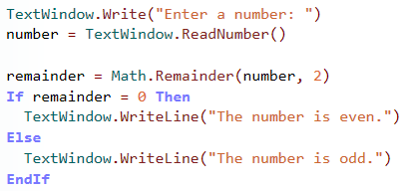

Slide 4
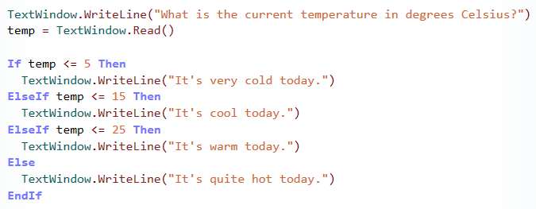

Slide 5

Loops in Small Basic Programs
You can use a loop to instruct the computer to run one or more statements more than once.
You can use a For loop if you know how many times you want the computer to repeat the instructions.
You can use a While loop if you want the program to repeat the instructions until a specific condition is true.
So, let’s explore some loop statements…

Slide 6
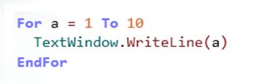
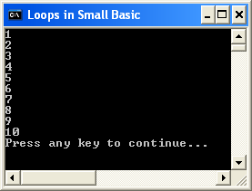

Loops in Small Basic Programs
Let’s start by writing a program that contains a For..EndFor loop.
In general, you use a For..EndFor loop to run code a specific number of times. To manage this type of loop, you create a variable that tracks how many times the loop has run.
Click the button on the Toolbar.
In this example, the variable contains a value that increases by 1 every time that the loop runs.
Notes:
Code:
For a = 1 to 10
TextWindow.WriteLine(a)
EndFor

Slide 7
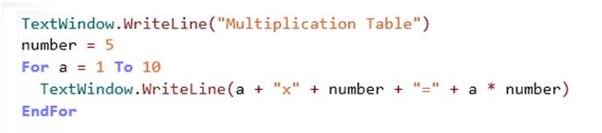
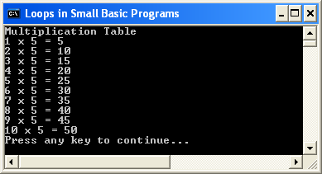
Loops in Small Basic Programs
Let’s use this concept to print the multiplication table for the number 5.
output
Notes:
In this program, you first use the WriteLine operation to display "Multiplication Table" on the screen.
Then you create the variable “number” to store the value of 5.
Then you create a For loop with the variable “a” to ensure the WriteLine operation will run 10 times.
You use the WriteLine operation to display the following elements in this order:
--the value that is stored in the “a” variable --the multiplication sign
--the value that is stored in the “number” variable
--the equals sign
--the products of the values of the “a” and “number” variables
Code:
TextWindow.WriteLine("Multiplication Table")
number = 5
For a = 1 to 10
TextWindow.WriteLine(a + " x " + number + " = " + a * number)
EndFor

Slide 8
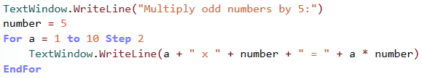
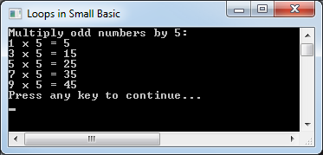
Loops in Small Basic Programs
In the previous example, the value of the counter variable in a For loop increases by 1 every time the loop runs. However, you can increase the value by another number if you use the Step keyword.
For example, you can increase the value by 2 if you write the following code:
Notes:
You can even decrease the value of the loop variable every time that the code runs if you use the Step keyword but specify a negative number. For example, you can write a program that counts backward from 10 to 1 on the screen if you assign the value of -1 to the Step keyword.
Code:
TextWindow.WriteLine("Multiply odd numbers by 5:")
number = 5
For a = 1 to 10 Step 2
TextWindow.WriteLine(a + " x " + number + " = " + a * number)
EndFor

Slide 10
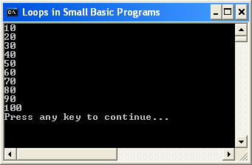
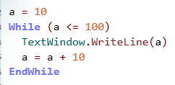
Loops in Small Basic Programs
If you don’t know the loop count before you write a program, you can create a While loop instead of a For loop.
When you create a While loop, you specify a condition that is true when the loop starts. But the computer evaluates the condition every time that the loop repeats. When the condition becomes false, the loop stops.
Let’s write the following program to demonstrate the While loop:
Notes:
In this example, you first create the “a” variable and set its value to 10.
Next, you create a While loop with a condition that the value of the “a” variable is smaller than or equal to 100. Because you just set the value of that variable to 10, the condition is true when the loop starts.
You use the WriteLine operation to display the value of the “a” variable every time that the loop runs.
In the next statement, you increase the value of the “a” variable by 10 every time that the loop runs.
The loop stops after it runs 10 times because the value of the “a” variable becomes larger than 100.
Code:
a = 10
While (a <= 100)
TextWindow.WriteLine(a)
a = a +10
EndWhile

Slide 12

Let’s Summarize…
Congratulations! Now you know how to:
Write programs that evaluate logical conditions and perform operations based on those results.
Write programs that repeat one or more instructions either a specific number of times or based a logical condition.

Slide 13

Show What You Know
Create a program to convert one or more student scores from a percentage to a letter grade. First, ask the user to specify how many grades will be calculated. Then ask the user to specify the first percentage, and convert it to a letter grade based on the following criteria:
If the percentage is more than 75, convert it to an A.
If the percentage is less than 75 but more than or equal to 60, convert it to a B.
If the percentage is less than 60 but more than or equal to 35, convert it to a C.
If the percentage is less than 35, convert it to a D.
Notes:
Solution:
TextWindow.Write("How many student grades would you like to calculate? ")
number = TextWindow.Read()
n = 1
While n <= number
TextWindow.Write("What is the student’s percentage? ")
percentage = TextWindow.Read()
If percentage >= 75 Then
TextWindow.WriteLine("The student’s grade is A.")
ElseIf percentage < 75 And percentage >= 60 Then
TextWindow.WriteLine("The student’s grade is B.")
ElseIf percentage < 60 And percentage >= 35 Then
TextWindow.WriteLine("The student’s grade is C.")
Else
TextWindow.WriteLine("The student’s grade is D.")
EndIf
n = n + 1
EndWhile

